Slide 1
Chapter 7 Quicksort
Hsu, Lih-Hsing

Slide 2
7.1 Description of quicksort
Divide: partition the list into two disjoint sub-lists
Conquer: Sort each sub-list independently
Combine: Output the concatenation of two sorted sub-lists
QUICKSORT(A, p, r)
1 if p < r
2 q ← PARTITION(A, p, r)
3 QUICKSORT(A, p, q-1)
4 QUICKSORT(A, q+1, r)

Slide 3
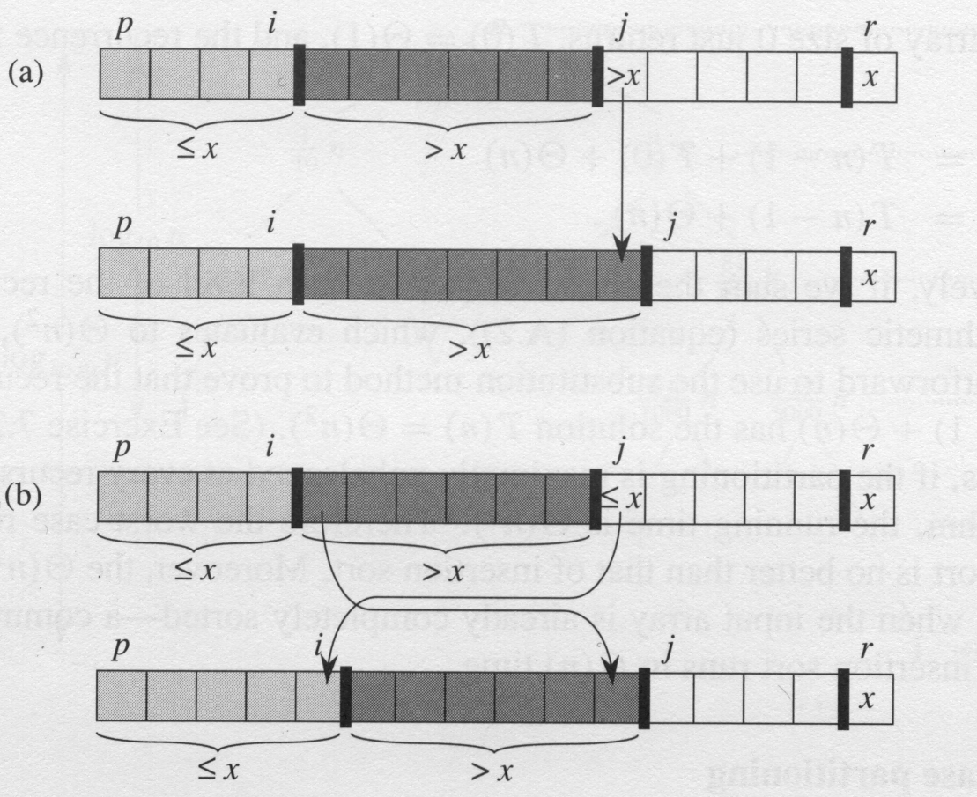
Partition(A, p, r)
i: index of the current
small number
j: index of the number
to be examined
1 x ← A[r]
2 i ← p – 1
3 for j ← p to r -1
4 do if A[j] ≤ x
5 then i ← i + 1
6 exchange A[i] ↔ A[j]
7 exchange A[i +1] ↔ A[r]
8 return i +1

Slide 4
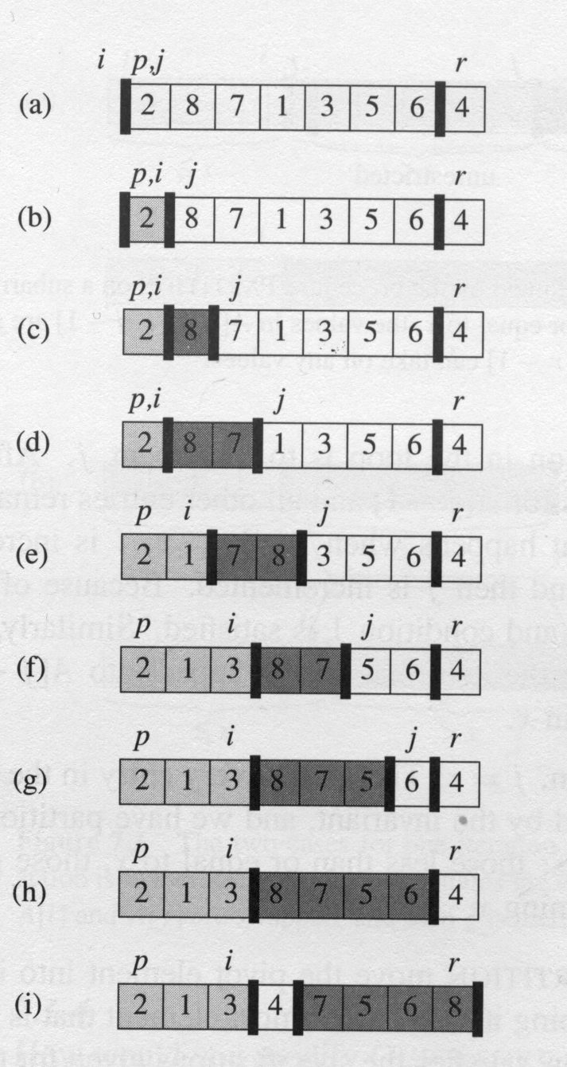
The operation of Partition on a sample array

Slide 5
Loop invariants: At the beginning of each iteration of the loop of lines 3-6, for any array index k,
1. if p ≤ k ≤ i, then A[k] ≤ x.
2. if i+1 ≤ k ≤ j-1, then A[k] > x.
3. if k = r, then A[k] = x.

Slide 6
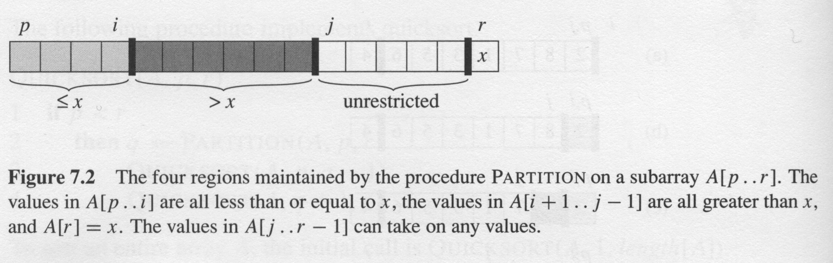
Two cases for one iteration of procedure Partition
Complexity:
Partition on A[p…r] is Θ(n)
where n = r – p +1

Slide 7
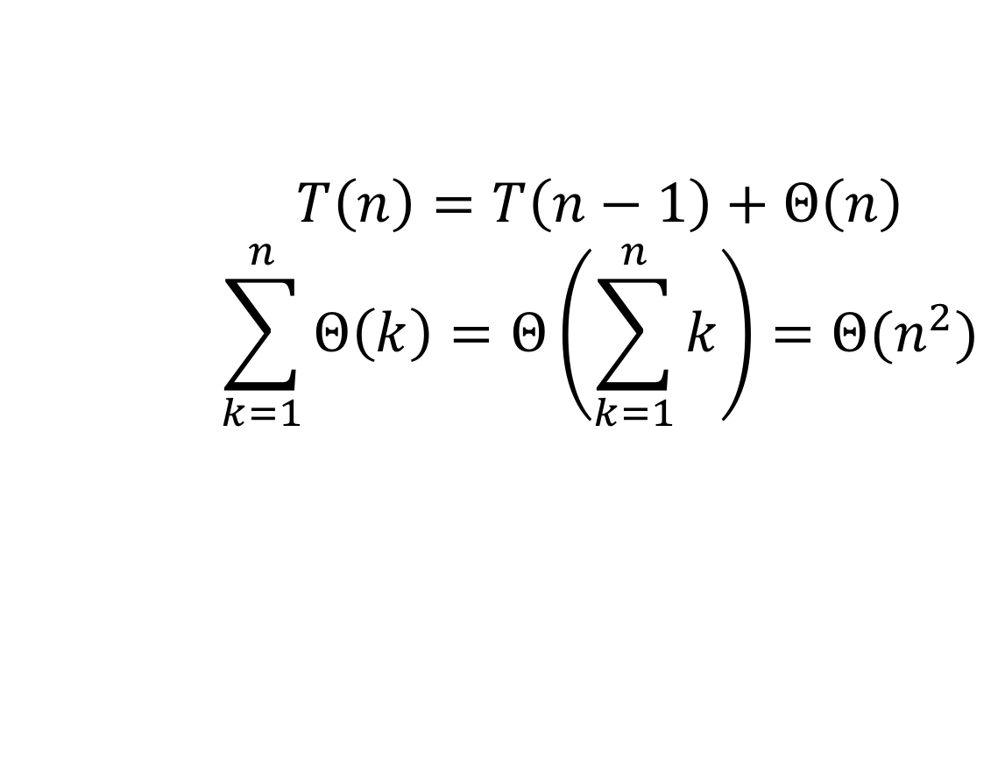
7.2 Performance of quicksort
Worst-Case Partition
$$T\left(n\right)=T\left(n−1\right)+Θ\left(n\right)$$
$$\sum_{k=1}^{n}{Θ\left(k\right)=Θ\left(\sum_{k=1}^{n}{k}\right)=Θ(n^{2}})$$

Slide 8
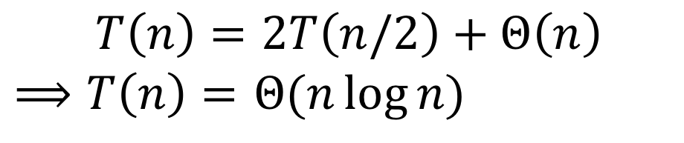
7.2 Performance of quicksort
Best-Case Partition
$$T\left(n\right)=2T\left(n/2\right)+Θ\left(n\right)$$
$⟹T\left(n\right)=$ $Θ(n\log{n})$

Slide 9
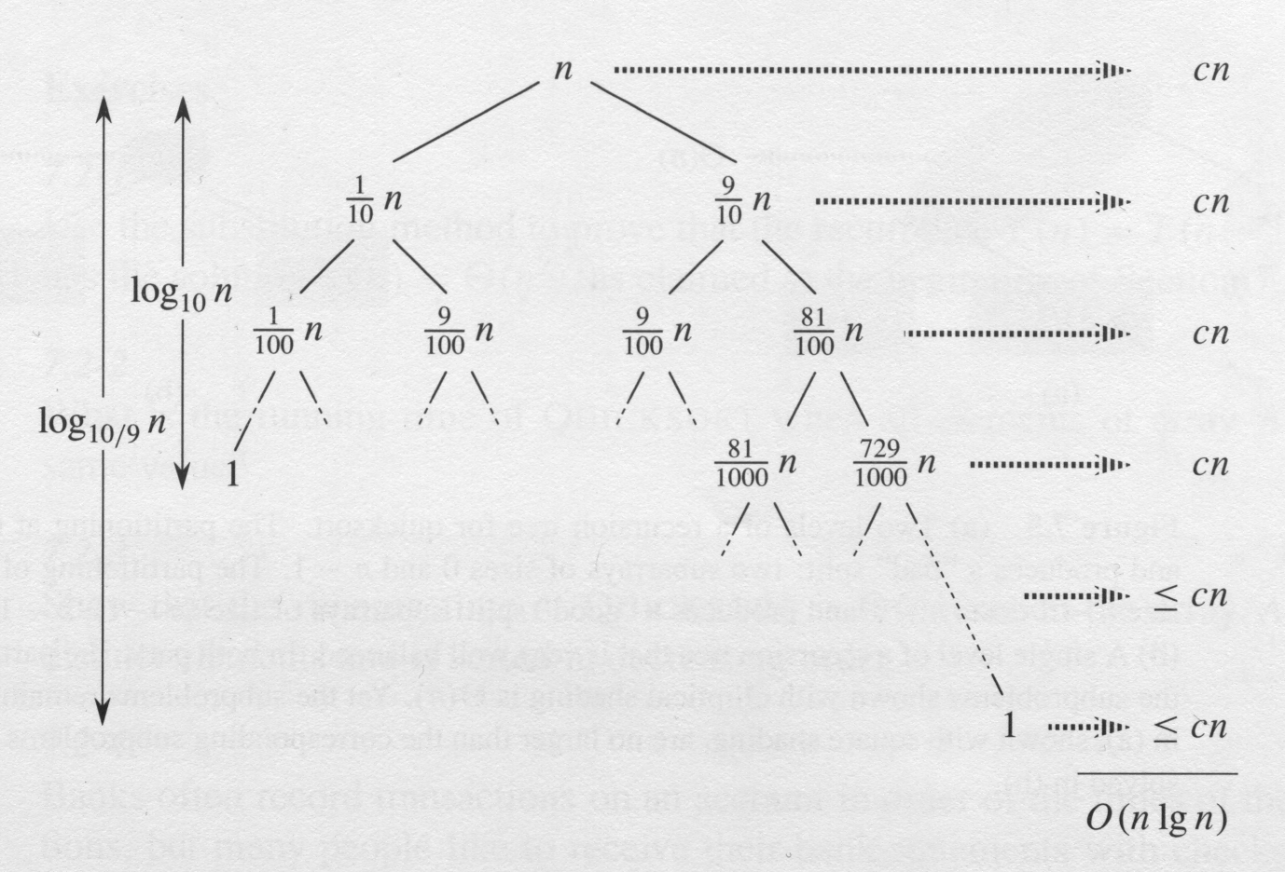
Any split of constant proportionality yields a recursion tree of depth , where the cost at each level is O(n).

Slide 10
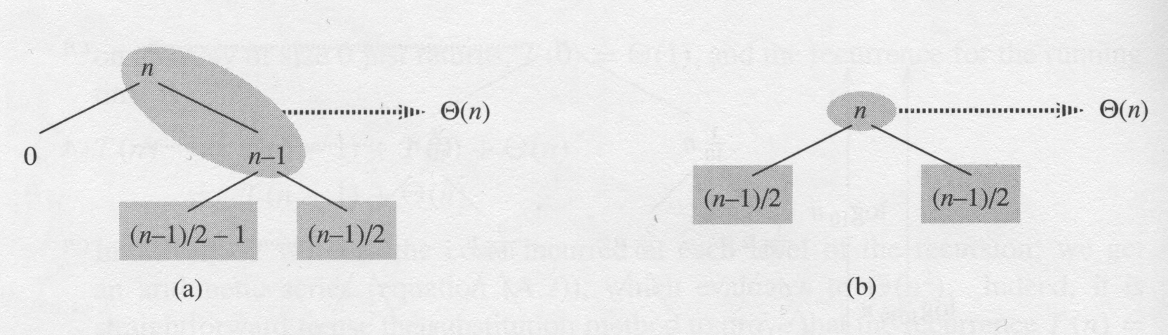
Intuition for the average case T(n) = Θ(n log n)
All permutations of the input numbers are equally likely

Slide 11
7.3 Randomized Quicksort
Randomized_Partition(A, p, r)
1. i = Random(p, r)
2. exchange A[r] with A[i]
3. return Partition(A, p, r)
Randomized_Ruicksort(A, p, r)
1. if p < r
2. q = Randomized_Partition(A, p, r)
3. Randomized_Ruicksort(A, p, q-1)
4. Randomized_Ruicksort(A, q+1, r)

Slide 12
7.4 Analysis of quicksort

Slide 14
7.4.2 Expected running time
Running time and number of comparisons
Lemma 7.1
Let X be the number of comparisons performed in line 4 of partition over the entire execution of Quicksort on an n-element array. Then the running rime of Quicksort is O(n+X)

Slide 15
Let z_{i} be the ith smallest element
We define {z_{i} is compared to z_{j}},
{z_{i} is compared to z_{j}}

Slide 16
Pr{z_{i} is compared to z_{j}} = Pr{z_{i} or z_{j} is first pivot chosen from Z_{ij}}
= Pr{z_{i} is first pivot chosen from Z_{ij}}
+ Pr{z_{j} is first pivot chosen from Z_{ij}}

Slide 18
Another Analysis

